Slide 1
NH3 trend in Africa drove by biomass burning, wetlend extend or agriculture
Zhenqi Luo 2020.12

Slide 2
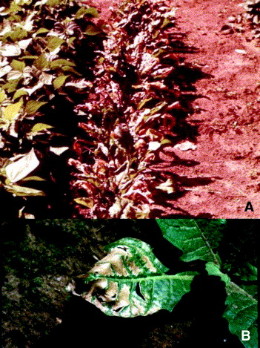
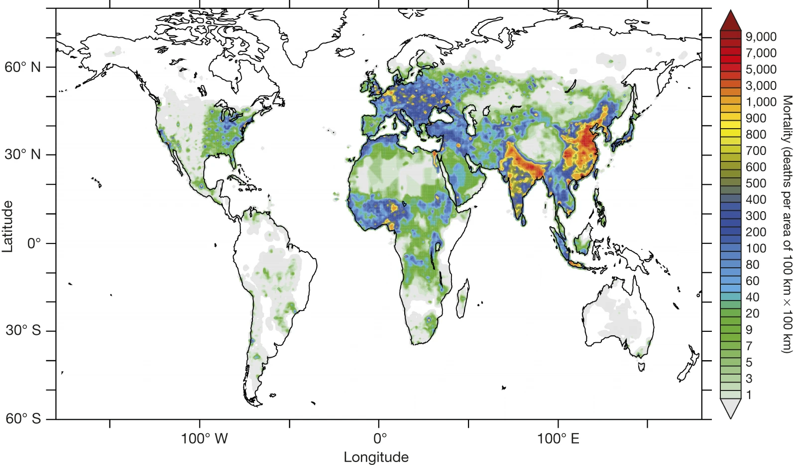
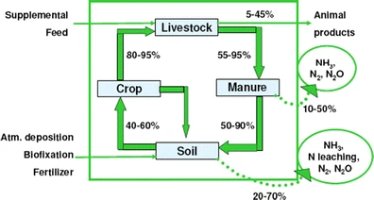

NH3 trend in Africa (2008-2017)
Atmosphere NH3 implications
inorganic aerosols production
fine particulate matter constituent
health hazard
deposited to ecosystems:
Eutrophication
soil acidification
vegetation damage
productivity declines
reductions in biodiversity
indirect greenhouse gas emissions
NH3 source
Agriculture: the global largest source
urea fertilizer: extremely low in sub-Saharan Africa
livestock excreta: very low in sub-Saharan Africa
soil: ammonium dissociation (${NH}_{4}^{+}+{OH}^{−}↔H_{2}O+{NH}_{3}$)
temperature-dependent
plant and soil physiological and physical factors
Biomass burning: 60-70% from Africa
Determinant: fuel moisture content
Detailed Regions:
West Africa
the Lake Victoria Region
South Sudan
Mortality linked to outdoor air pollution in 2010
table beet exposed to acute NH3 concentrations
(Lelieveld et al., 2015, Nature)
(Krupa 2015, Environ Pollut)
(Behera et al., 2013)
N cycling and losses in a livestock farming system
Notes:
https://doi.org/10.5194/acp-2020-945

Slide 3
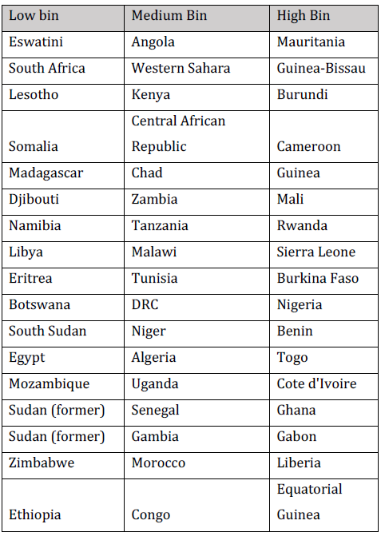
NH3 trend in Africa (2008-2017)
Global data:
IASI-A: NH3, CO
regrid: 0.25° × 0.25°
Time: morning
cloud cover: < 20%
TRMM: daily precipitation
NOAA Global Surface Temperature Dataset: 0.5° gridded 2m monthly
MODIS MCD64A1: 0.25° gridded monthly burned area
MODIS MCD12C1: 0.25° gridded land cover product
ACLED: violent and non-violent conflict events
Wetland extent: Sudd
MODIS MOD09A1: monthly flood maps (8-days)
First stage: distinguish
wetland vegetation classes
flooding regimes: seasonally flooded
Second stage:
compares seasonally flooded to non-flooded
identify the timing and duration of flooding
Spatial relationships: (0.25°)
mean annual tropospheric NH3 concentration
independent variables
population density: USDEGL population dataset (2017 version)
livestock density: FAO (2007)
cropped area: MODIS MCD12C1
National analyses: UN FAOSTAT (51 African countries)
livestock numbers
crop production
fertilizer N use
Countries were sorted into three bins
(Hickman et al., 2020)
Notes:
refer to Di Vittorio and Georgakakos (2018) for a detailed description of the classification procedure Countries were sorted into three bins based on whether their relative change in mean annual NH3 concentration was low, medium or high

Slide 4
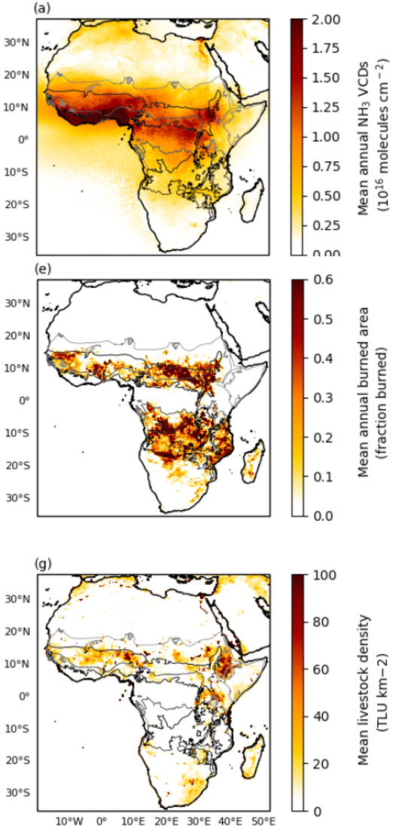
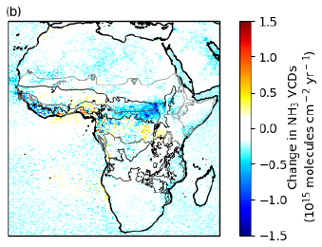
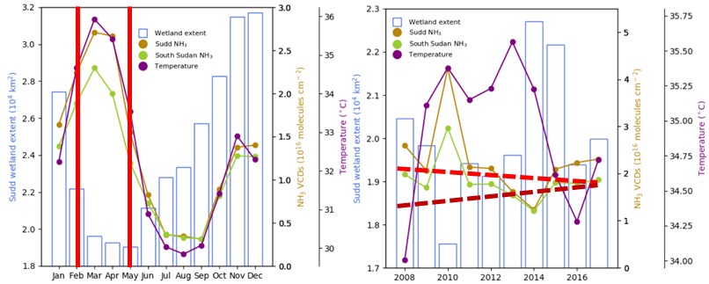
Results——Africa (2008-2017)
Continental distributions
Highest in West Africa: biomass burning
regional hotspots:
the Lake Victoria Basin
along the Nile delta and river
Continental trends
Increases
the northern grasslands: during February and March
Nile region
the Lake Victoria Basin
Decline: South Sudan
Seasonal: increase as waters recede——from February to May
Interannual: an overall increase in the minimum flooded extent (r=-0.69)
(Hickman et al., 2020)
Notes:
savannas and forest-savanna
the effects of drying on concentrations of NH3 in solution, reduced biological uptake of NH3, convective transport of dissolved NH3 from depth to the soil surface, and increased mineralization of labile organic matter (Clarisse et al., 2019).

Slide 5
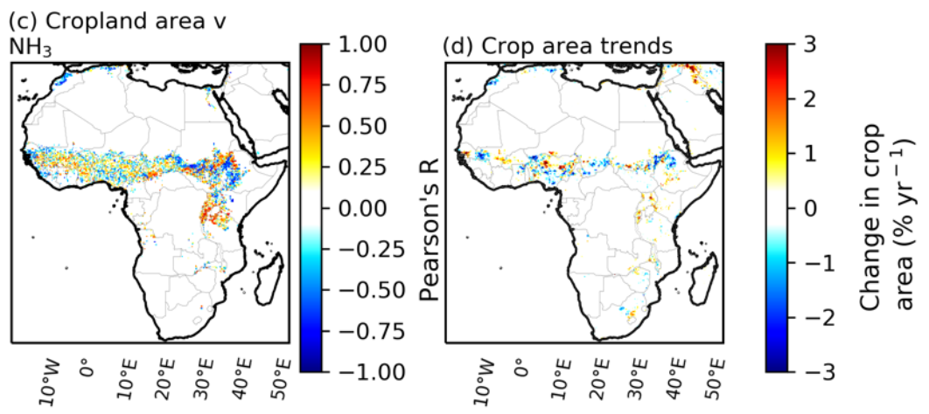
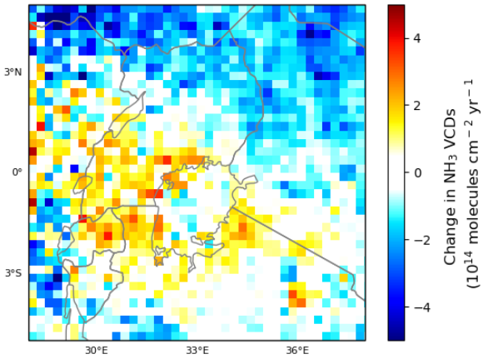
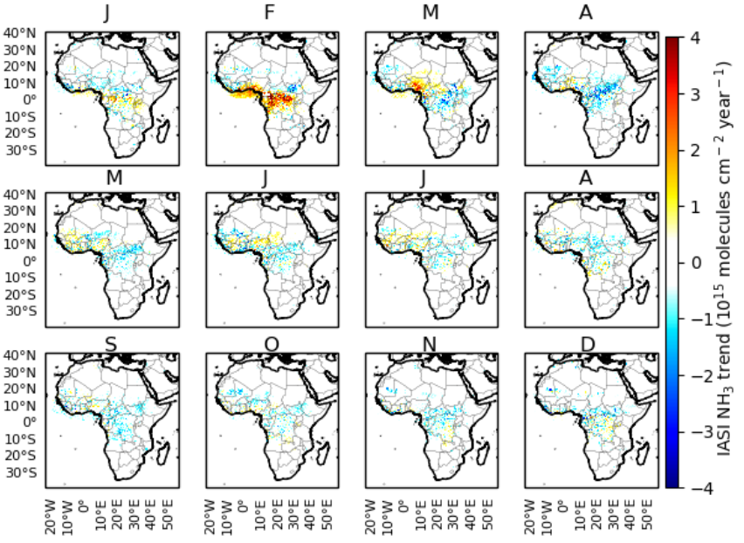
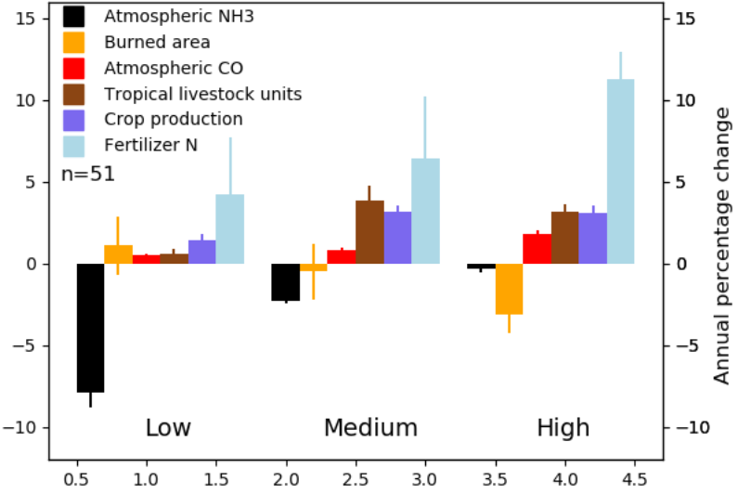
Results——Africa (2008-2017)
regional hotspots:
the Lake Victoria Basin: increasing agricultural activity
increasing density of agricultural land
positively correlated with increases in NH3
National-scale relationships
relationship between agriculture and NH3
changes in biomass burning
(Hickman et al., 2020)
Notes:
savannas and forest-savanna

Slide 6
Questions?

